Slide 1
SQL and Databases
Verónica Quintero Valencia
Jhan Carlos Lucio Ríos
Rafael Mauricio Giraldo Gallego
File: 1597568

Slide 2

It is a structure that contains different categries of information
What are Databases?
www.genbetadev.com/bases-de-datos/3-bases-de-datos-nosql-mas-populares-para-iniciarse-en-la-nube

Slide 3
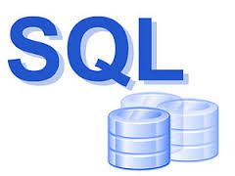
It is a query language structured. It is also a language of database normalized, used to consult ,modify or delete data from a database .
What is SQL?

Slide 4
Components
The SQL languaje is composed of commands , cláuses, operators and aggregate functions

Slide 5
Commands
Language definition (DDL).
Language manipulation (DML).
Language control (DCL).

